Slide 1
DATA VISUALIZATION
27.06.2022

Slide 2
STRUCTURES FOR EVALUATING VISUALIZATIONS
Many forms of evaluation for interactive systems have been developed within the field of human-computer interaction, most of which are applicable and have been applied to data and information visualization systems.
i. Usability Tests
ii. Expert Reviews
iii. Field Tests
iv. Case study

Slide 3
Usability tests
These evaluations concentrate on “the Five E’s”:
effective,
efficient,
engaging,
error tolerant, and easy to learn.
These tests are usually carried out by observing users attempting to perform tasks, and noting the types of difficulties they are having, the features they commonly use, and their level of comfort/satisfaction with the tool.

Slide 4
Expert review
While some forms of evaluation depend on having a significant number of participants, expert reviews can generally be carried out with a small number (three or fewer) of qualified reviewers.
These evaluators may be experts in visualization, or they may be domain experts who can thoroughly test the applicability of a tool for a set of specific application tasks.
A domain expert, on the other hand, is generally familiar with the types of data and tasks found within their domain, and will attempt to identify the extent to which the system or technique could accommodate the data and support the tasks.

Slide 5
Field tests & usecases
Unlike usability tests, which are often carried out in a controlled environment over a short period of time to better enable measurement, field tests are performed in the natural environment of the typical user and may last for weeks or months.
Rather than using experts, users, or student volunteers in evaluation, some visualization researchers attempt to validate the effectiveness of their techniques by showing real (or sometimes contrived) examples of how their method can be used in solving a particular problem or performing a given task.

Slide 6
VISUALIZATION SYSTEMS
i. Systems based on Data Type
ii. System based on Analysis Type

Slide 7
System based on Data type – scientific
OpenDX, which was formerly marketed as IBM Visualization Data Explorer, is an extensible visualization environment primarily used for the analysis of scientific and engineering data.
What separates it from most other visualization platforms is the visual programming process used to create custom visualizations.
Its Network Editor allows users to drag-and-drop components onto a canvas and create links between components for communicating data of specified types. The modules fall into several distinct classes, including

Slide 8
• import and export—modules to load and save data in different formats;
• flow control—modules to create loops and conditional execution;
• realization— modules to map the data to renderable entities, such as isosurfaces, grids, and streamlines;
• rendering—modules to control display attributes, such as lighting, cameras, and clipping;
• transformation—functions to apply to the data, such as filtering, mathematical functions, and sorting;
• interactor—widgets such as file selectors, menus, dials/sliders, and button boxes.

Slide 9
Systems based on Multivariate data
XmdvTool [280], developed at Worcester Polytechnic Institute (WPI) by Matthew Ward, Elke Rundensteiner, and their students, is a public domain visualization software package that integrates five common methods for multivariate data visualization into a single exploration application.
This tool includes standard scatterplot matrices, scatterplots of star glyphs, parallel coordinates, dimensional stacking, and pixel-oriented techniques.
These visualizations are linked together using a simple selection and highlighting mechanism called an N-dimensional brush, which defines a hyperbox in the data space.
Selected data in one view are also selected in other views, and the resulting selection can be highlighted, masked, deleted, or analyzed separate from the rest of the data

Slide 10
System based on analysis type - STATISTICS
The system continues to evolve, with many others contributing to its development. It supports a number of different visualizations, including scatterplots, scatterplot matrices, bar charts, graphs, and parallel coordinates.
For each visualization, a control panel specific to that view is shown; clicking on any visualization exposes its control panel.
Color is used to link data between multiple views, and the user has a wide range of options for controlling the colors assigned to graphical entities.
The user starts by selecting a data dimension to control the color; an interactive histogram can then be used to adjust the ranges of values assigned to each color .

Slide 11
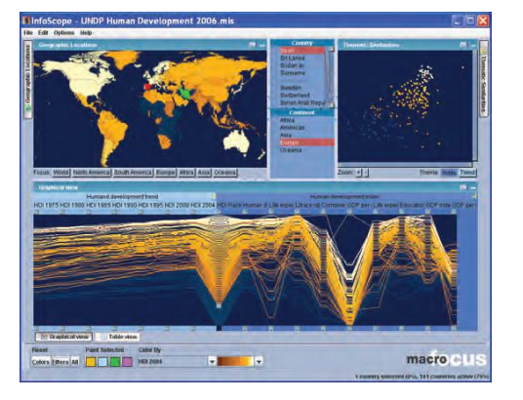
System based on analysis type – SPATIO TEMPORAL
Macrofocus has produced a number of powerful interactive tools for visually exploring data and information. One such tool is InfoScope, which links geographic views with several other visual and textual representations of information.

Slide 12
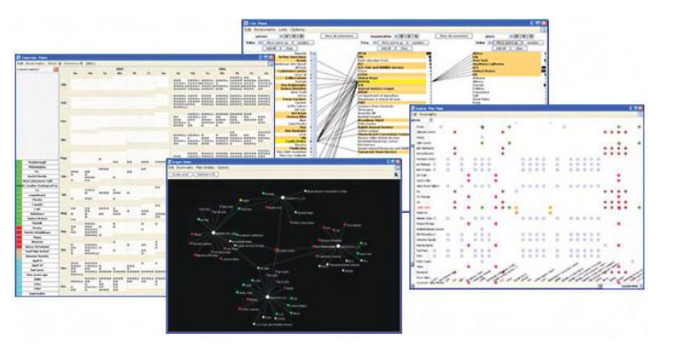
TEXT ANALYSIS AND VISUALIZATION
Jigsaw is a text visualization tool that was developed by John Stasko and his students at the Georgia Institute of Technology.
This system explores entities (people, places, dates, money) and the relationships between them. Jigsaw uses several different views to present information to the user, including calender, list, graph, scatterplot, text, and time line views.
Each view is presented as a separate window that updates automatically with the results of various queries

Slide 13
MODERN INTEGRATED VISUALIZATION SYSTEMS
Tableau is a commercial software package initially developed by Pat Hanarahan and his students at Stanford. It is designed with more modern interactions to aid in data analysis.
Tableau allows users to import data from a wide variety of formats. It provides standard visualizations, such as graphs, scatterplots, bar charts, and pie charts, as well as maps.
Tableau recognises data types such as geography, and automatically handles the first steps in the generation of visualizations. It also supports the export of annotated presentation visualizations in PDF format and provides interactive dashboards that automatically update from data sources, as well as web publishing tools

Slide 14
STUDENT ASSIGNMENT
TOOLSKITS
ALL THE BEST FOR YOUR FUTURE
hafeezskhbablu@gmail.com
+91-8686561232

